Slide 1
Data Mining
Nga Than, Hunter College, 02/24/20

Slide 2
Announcements
Problem set 2 have been graded
Problem set 3 issues?

Slide 3
Research Pitch
What are your ideas for a research project?
What is your research topic?
Why do you think it’s feasible for this semester?
Where do you find the data?
Why should other work with you?

Slide 4
Packages
What is package?
A package is a suitable way to organize your own work and, if you want to, share it with others.
Typically, a package will include code (not only R code!), documentation for the package and the functions inside, some tests to check everything works as it should, and data sets.

Slide 5
Packages
The basic information about a package is provided in the DESCRIPTION file, where you can find out what the package does, who the author is, what version the documentation belongs to, the date, the type of license its use, and the package dependencies.
Besides finding the DESCRIPTION files on websites like cran.r-project.org or stat.ethz.ch, you can also access the description file inside R with the command packageDescription("package"), via the documentation of the package help(package = "package"), or online in the repository of the package.

Slide 6
Example
For example, for the “stats” package, these ways will be:
packageDescription("stats")
help(package = "stats")

Slide 7
Repositories
A repository is a place where packages are located so you can install them from it.
Two types of repos:
CRAN: the official repository, it is a network of ftp and web servers maintained by the R community around the world. The R foundation coordinates it, and for a package to be published here, it needs to pass several tests that ensure the package is following CRAN policies. You can find more details here.
Github : although this is not R specific, Github is probably the most popular repository for open source projects. Its popularity comes from the unlimited space for open source, the integration with git, a version control software, and its ease to share and collaborate with others. But be aware that there is no review process associated with it.

Slide 8
Installing Packages from CRAN
The most common way is to use the CRAN repository, then you just need the name of the package and use the command
install.packages("package")
When you install a package, a long list of messages will output to your console. These are the messages of the installation itself, the source code, the help, some tests, and finally, a message that everything went well and the package was successfully installed. Depending on what platform you are, these messages can differ.
To install more than a package at a time, just write them as a character vector in the first argument of the install.packages() function:
install.packages(c("stars", "sf"))

Slide 9
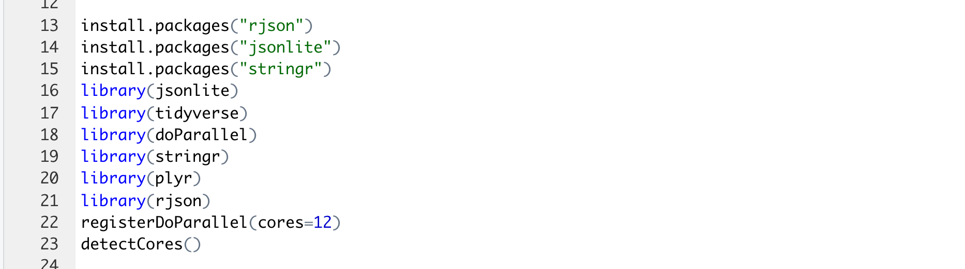
Example

Slide 10
Installing Packages via devtools
Another way is to install packages is to use the devtools package. It contains specific functions for each repository, including CRAN.
install.packages("devtools")

Slide 11
After devtools is installed
You will be able to use the utility functions to install other packages. The options are:
install_bioc() from Bioconductor,
install_bitbucket() from Bitbucket,
install_cran() from CRAN,
install_git() from a git repository,
install_github() from GitHub,
install_local() from a local file,
install_svn() from a SVN repository,
install_url() from a URL, and
install_version() from a specific version of a CRAN package.

Slide 12
Example - Structural Topic Modeling Package
https://github.com/bstewart/stm
library(devtools)
install_github("bstewart/stm",dependencies=TRUE)

Slide 13
Update, Remove and Check Installed Packages
To check packages that are installed on your computer:
installed.packages()
To uninstall a package:
remove.packages()
You can check what packages need an update with a call to the function:
update.packages()
To update a specific package, just use install.packages() again:
install.packages()

Slide 14
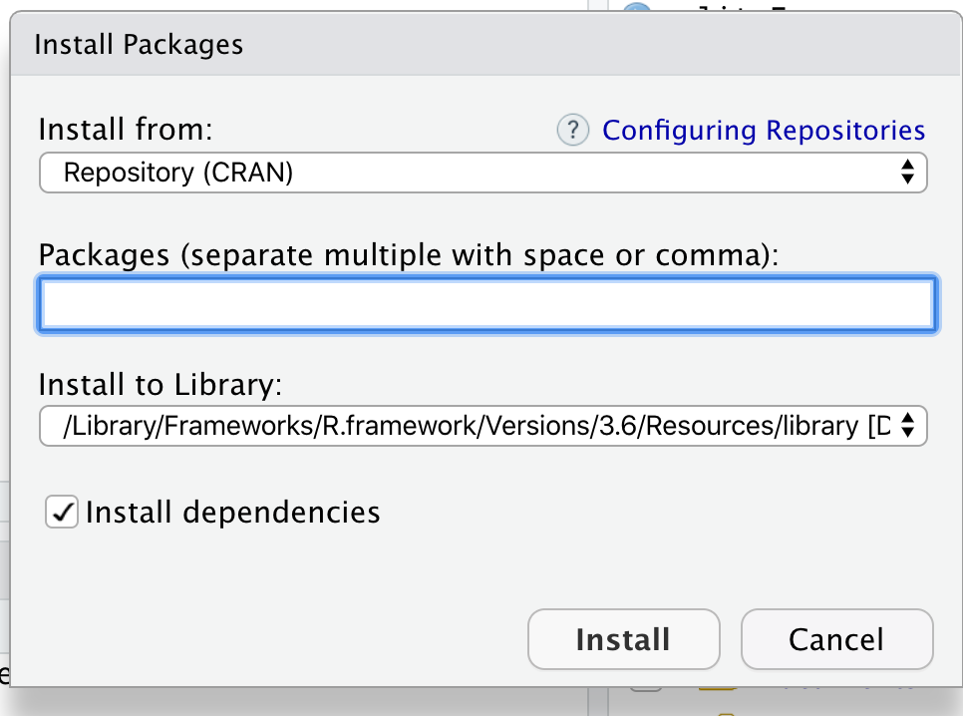
Installing Packages with RStudio
This method is not recommended, but one can use the Rstudio interface to do it.
Tools -> Install Package

Slide 15
Load Packages
After a package is installed, you are ready to use its functionalities.
Let’s try Tidyverse package. It contains a number of other packages suitable for data science.
install.package(“tidyverse”)
Access the band_instruments dataset
dplyr::band_instruments
Or:
library(dplyr)
band_instruments

Slide 16
Result
## # A tibble: 3 x 2
## name plays
## <chr> <chr>
## 1 John guitar
## 2 Paul bass
## 3 Keith guitar

Slide 17
Notes
Require() can also help you to call functionalities of a package, but use library() instead. It’s a better practice.

Slide 18
Unload a package
To unload a given package, you can use the detach() function:
detach("package:dplyr", unload = TRUE)

Slide 19
Vignettes
Another useful source of help included in most of packages are the vignettes, which are documents where the authors show some functionalities of their package in a more detailed way.
Example 1:
vignette(package = "dplyr")
vignette("dplyr")

Slide 20
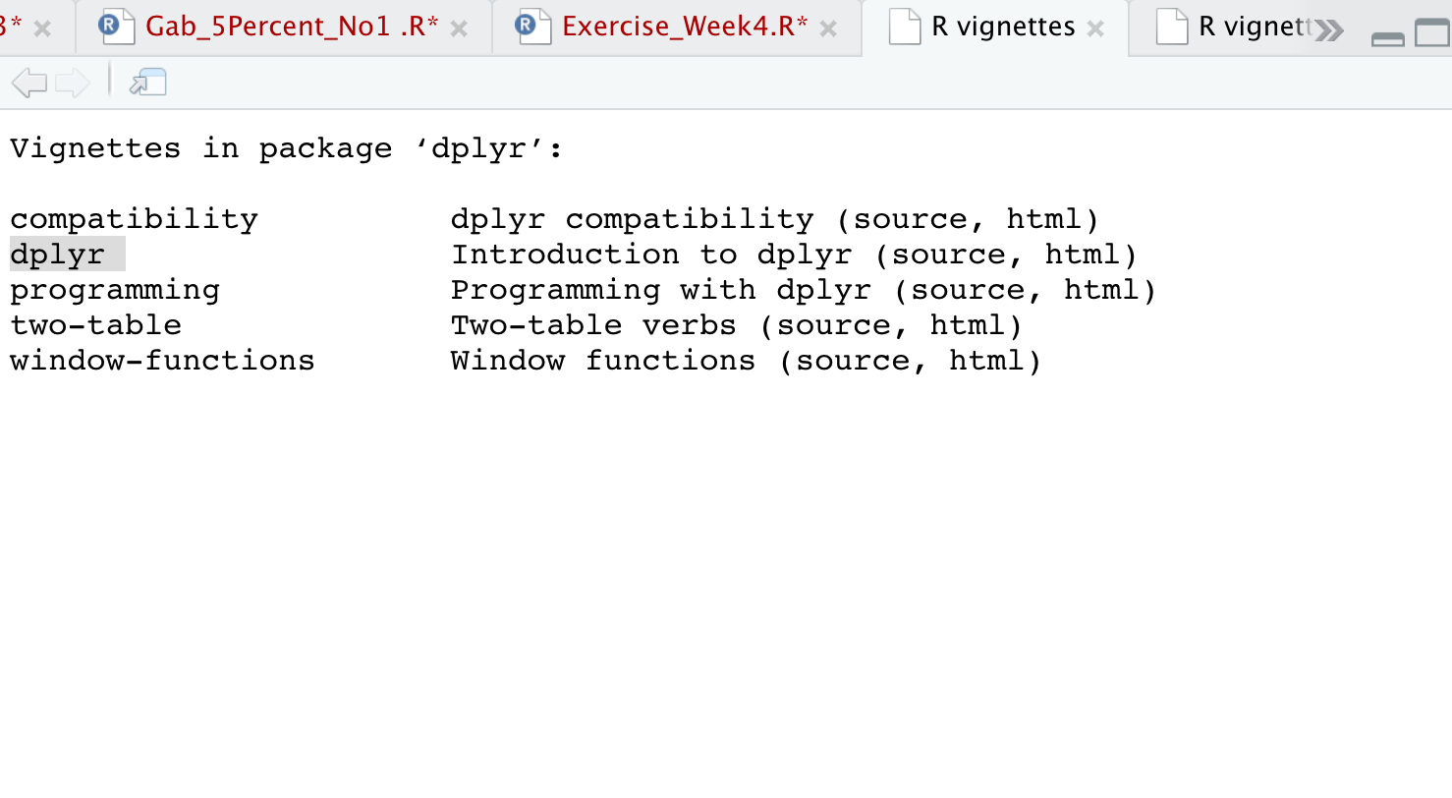
Example 1

Slide 21
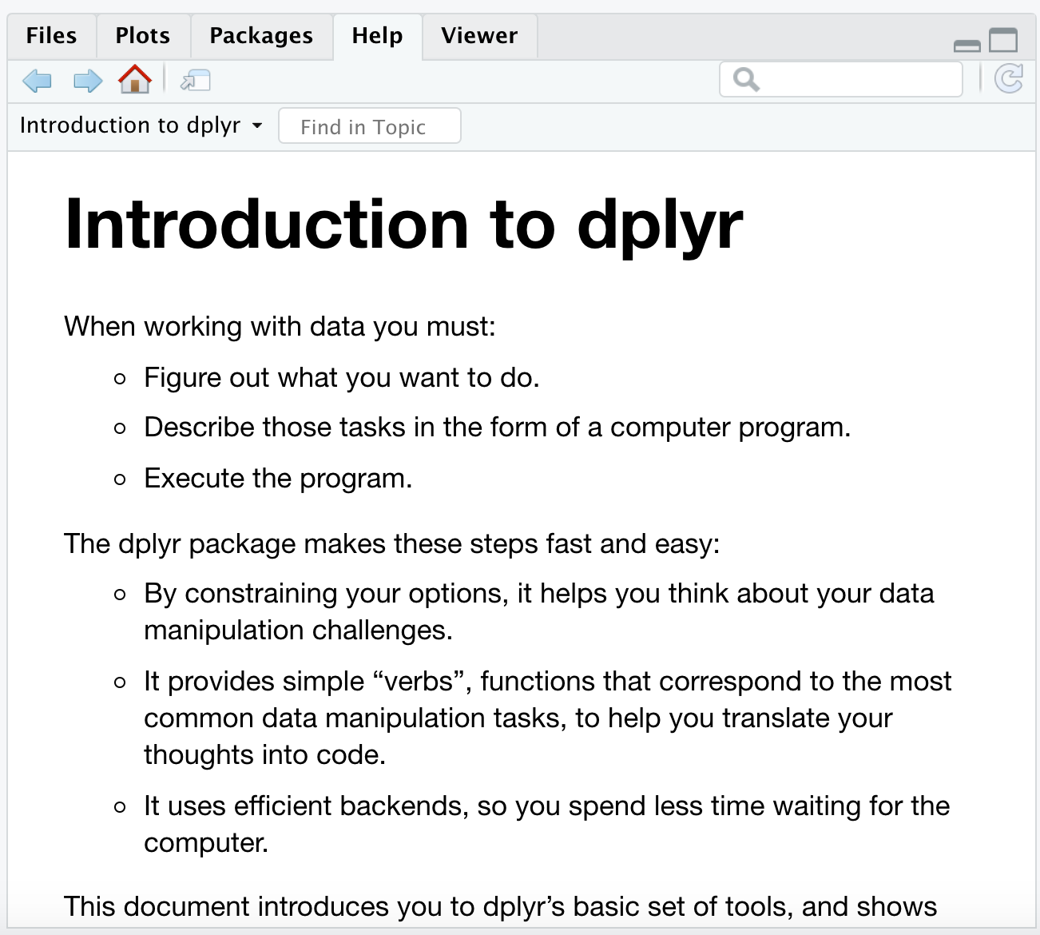
Example 1

Slide 22
Vignettes
Example 2:
vignette(package = "stm")
vignette("stmVignette")
See what shows up!

Slide 23
Useful Packages - Tidyverse
It is an ecosystem of R packages
Official definition: “The tidyverse is an opinionated collection of R packages designed for data science. All packages share an underlying design philosophy, grammar, and data structures.”
Each package within this ecosystem works seamlessly together for many purposes in data science: cleaning, transforming data, reading specific types of data, etc.

Slide 24
Common used packages within tidyverse
readr for importing data,
dplyr and tidyr for manipulating data, and
ggplot2 for visualizing data
You will learn more how to use each of them in the HW of this week
More on tidyverse: https://tidyverse.tidyverse.org/articles/paper.html

Slide 25
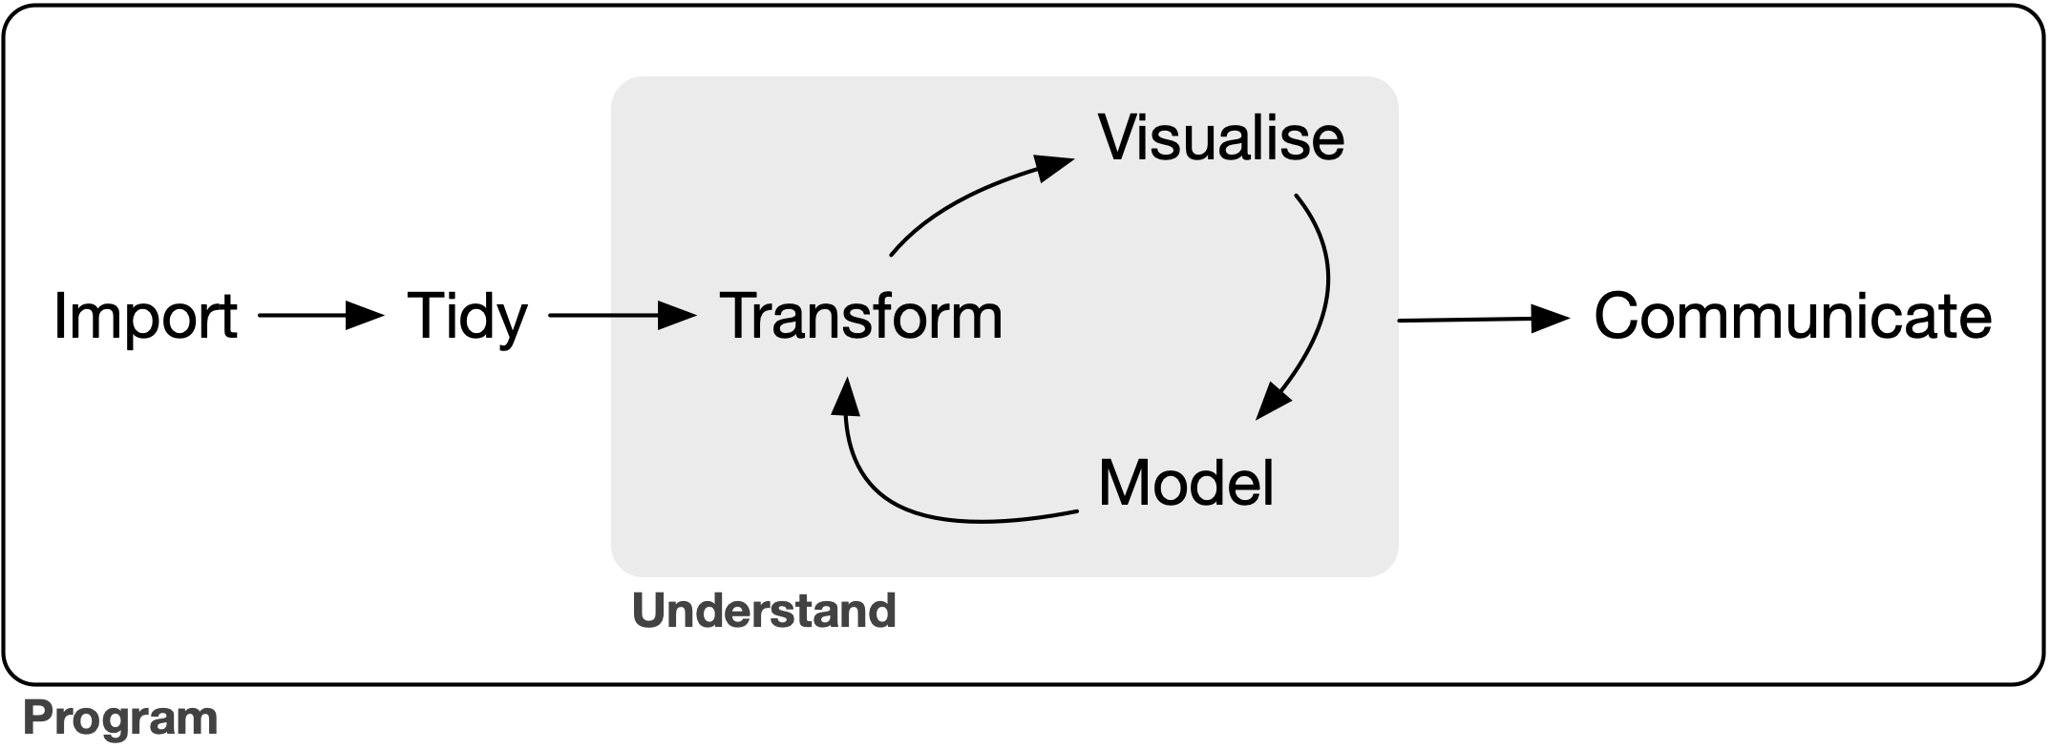
Workflow

Slide 26
Reproducibility
After you finish a project, you might want to share your code with others.
You can use sessionInfo() function to capture the specifics of your R code, your computer information, and what packages you used.
If you want to save the information:
si <- sessionInfo()
capture.output(si, file = "session_info.txt") # Save to txt file

Slide 27
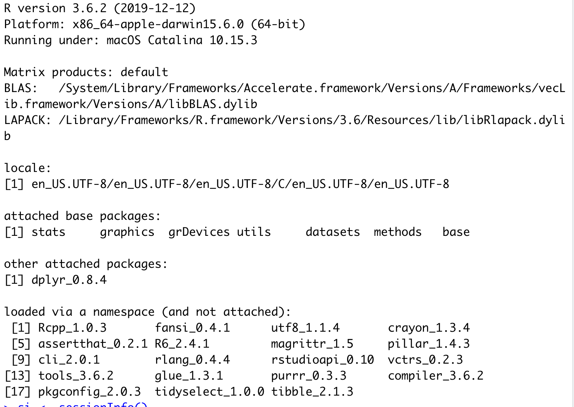
Example
sessionInfo()

Slide 28
Citing Packages
Packages should be cited like an academic paper in a research paper.
You can find out how you citation() to find out how to cite packages.
citation()

Slide 29
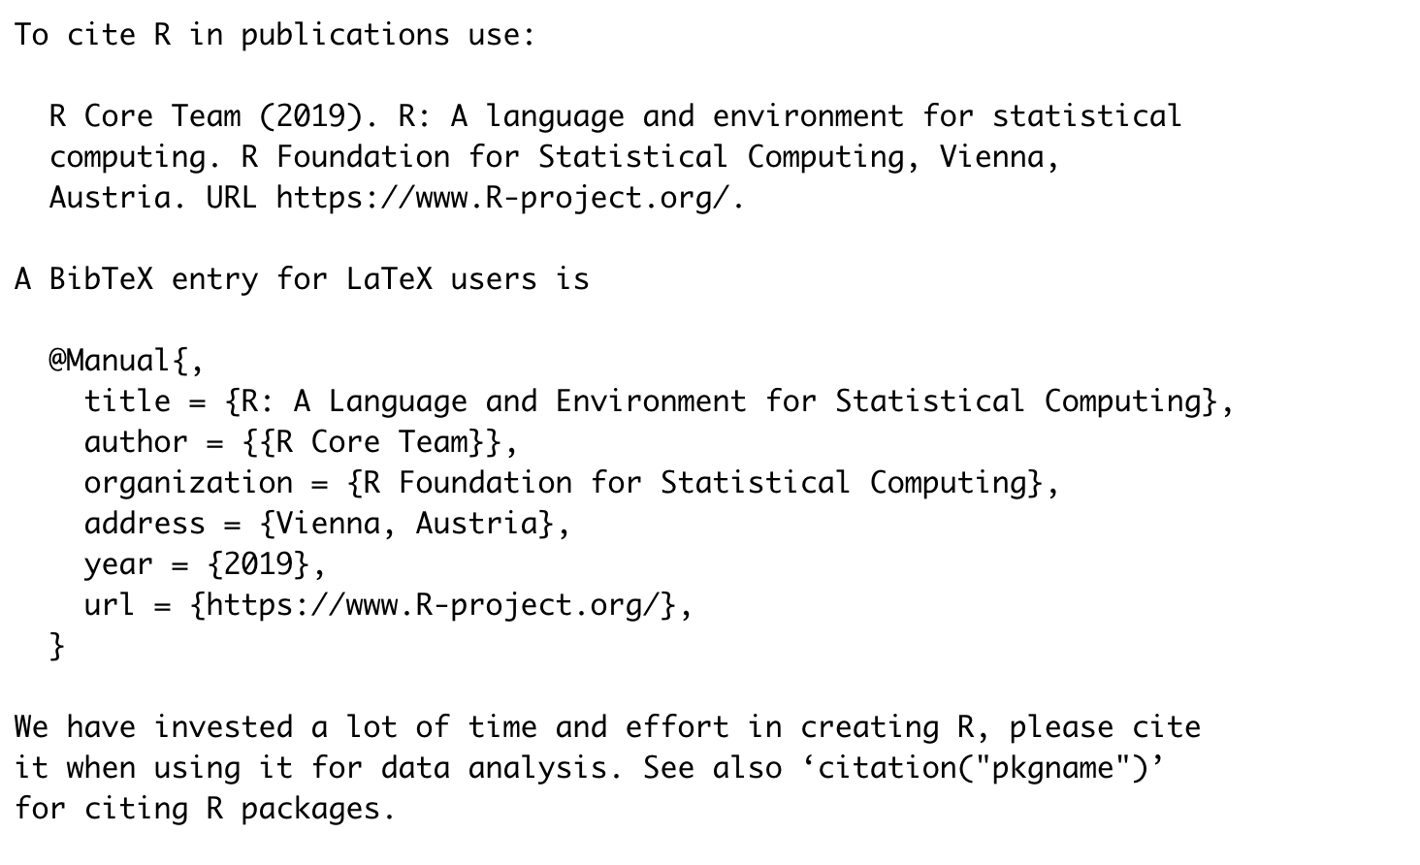
Citing Packages

Slide 30
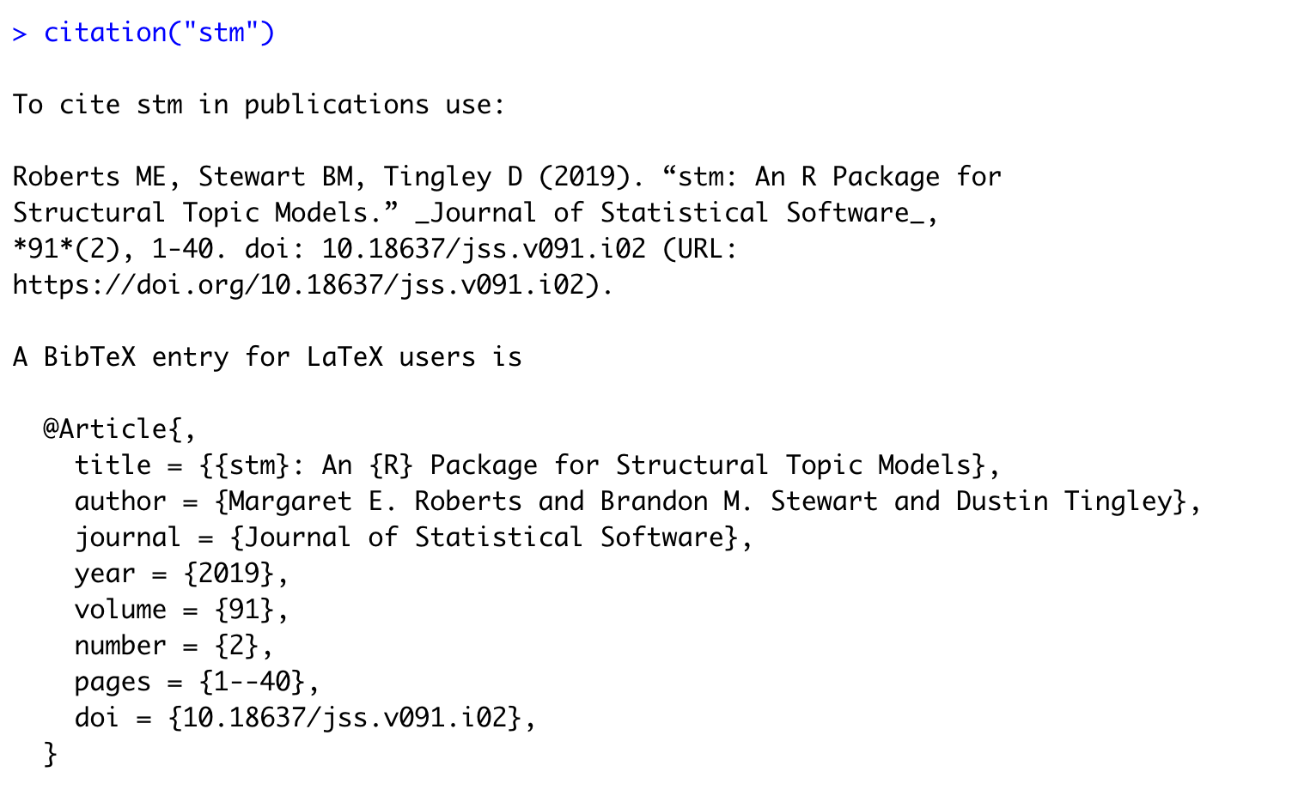
Citing a specific package - citation(“stm”)

Slide 31
Importing Data
Most often, you will import data from another source, unless you generate your own data.
Importing data as a task is not always straightforward as one would assume. It can lead to a lot of confusion, and frustration.

Slide 32
Reading in rectangular data
This is the most common data format ( csv files, excel spreadsheet, etc).
We use the readr package from the tidyverse ecosystem, which works for most rectangular datasets.
read_csv() reads comma-delimited files. .csv .txt
read_csv2() reads semicolon separated files (common in countries where , is used as the decimal place). .csv .txt
read_tsv() reads tab-delimited files. .tsv .txt
read_text() reads in space-delimited files. .txt
read_delim() reads in files with any delimiter (you specify it within the function). .txt

Slide 33
Example
library(readr)
Let’s try to read the data from this csv file from github:
https://github.com/connor-french/intro-r/blob/master/data/spotify.csv?raw=true
This is a csv file, which means it should be a rectangular data file.

Slide 34
Example - Importing data
Step 1: Store the path to file as an object:
spotify_path <- "https://github.com/connor-french/intro-r/blob/master/data/spotify.csv?raw=true"
Step 2: Read the csv file
spotify <- read_csv(spotify_path)

Slide 35
Example 1 - spotify
Examine the data:
summary(spotify)
colnames(spotify)
[1] "genre" "energy" "loudness" "tempo"
[5] "danceability" "lyrics"
Look at the data

Slide 36
Write Data
After working with dataframes in R, you also want to produce data for others to use:
write_csv(spotify, "spotify.csv")

Slide 37
Create a csv in R
read_csv("a,b,c
1,2,3
4,5,6")
# A tibble: 2 x 3
a b c
<dbl> <dbl> <dbl>
1 1 2 3
2 4 5 6

Slide 38
Read_csv()
In both cases read_csv() uses the first line of the data for the column names, which is a very common convention.

Slide 39
Reading other types of data
For rectangular data:
haven reads SPSS, Stata, and SAS files.
readxl reads excel files (both .xls and .xlsx).
odbc, along with a database specific backend (e.g. RMySQL, RSQLite, RPostgreSQL etc) allows you to run SQL queries against a database and return a data frame.
For hierarchical data:
jsonlite for the headache-inducing json format
xml2 for the equally frustrating xml format

Slide 40
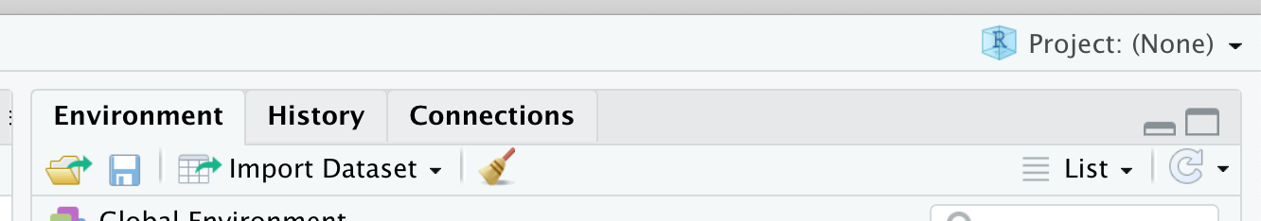
Reading with Rstudio
You can use point and click method to open many data files
Go to your environment:

Slide 41
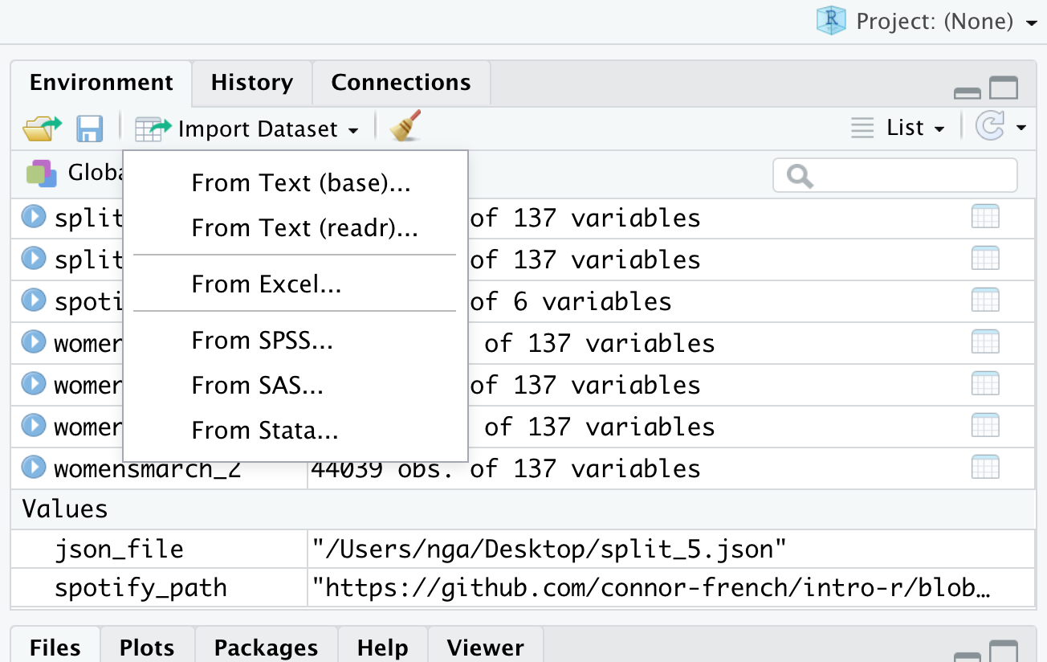
Rstudio (cont)
Click Import data set

Slide 42
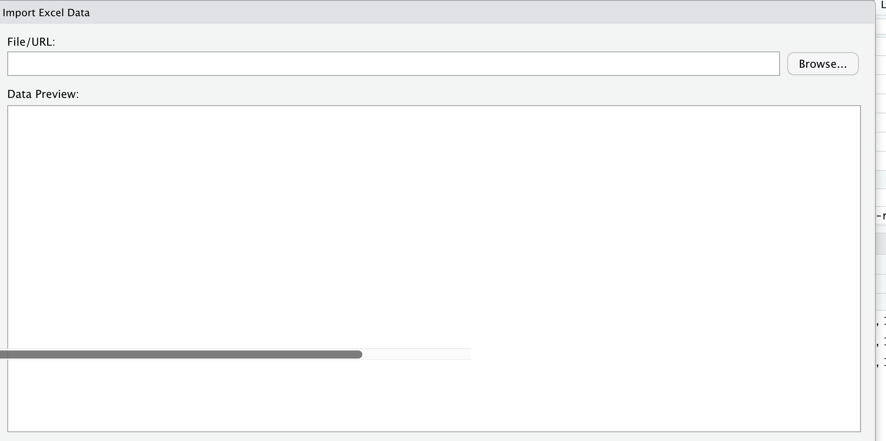
Rstudio (cont)

Slide 43
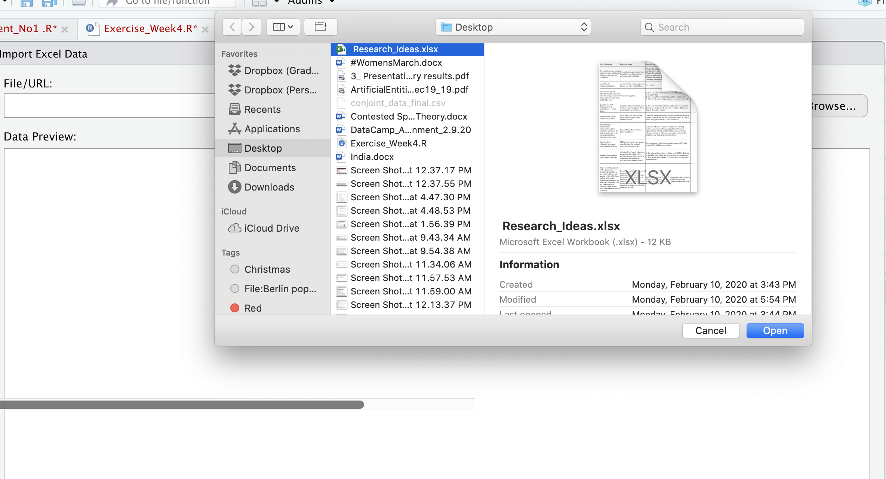
Rstudio (cont)

Slide 44
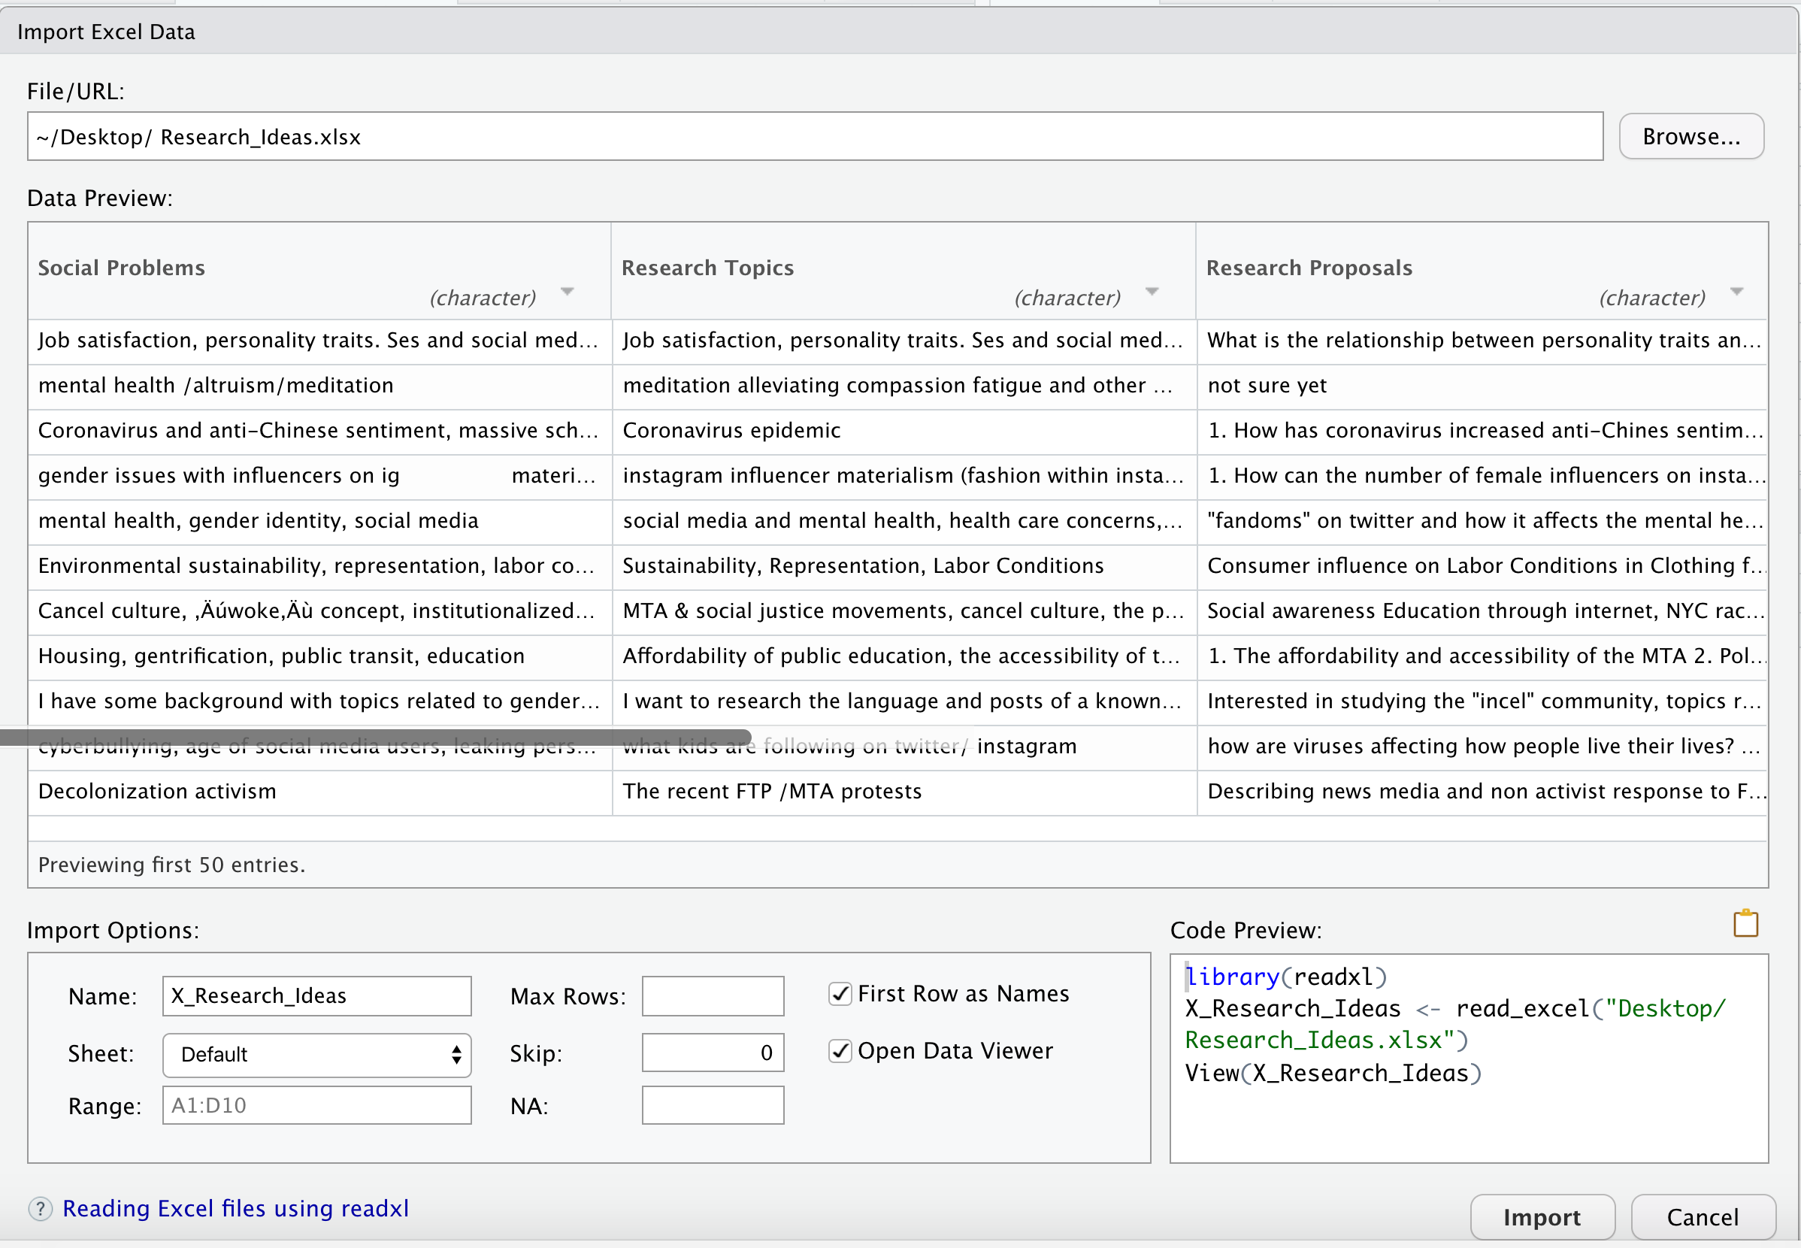
RStudio (Cont)

Slide 45
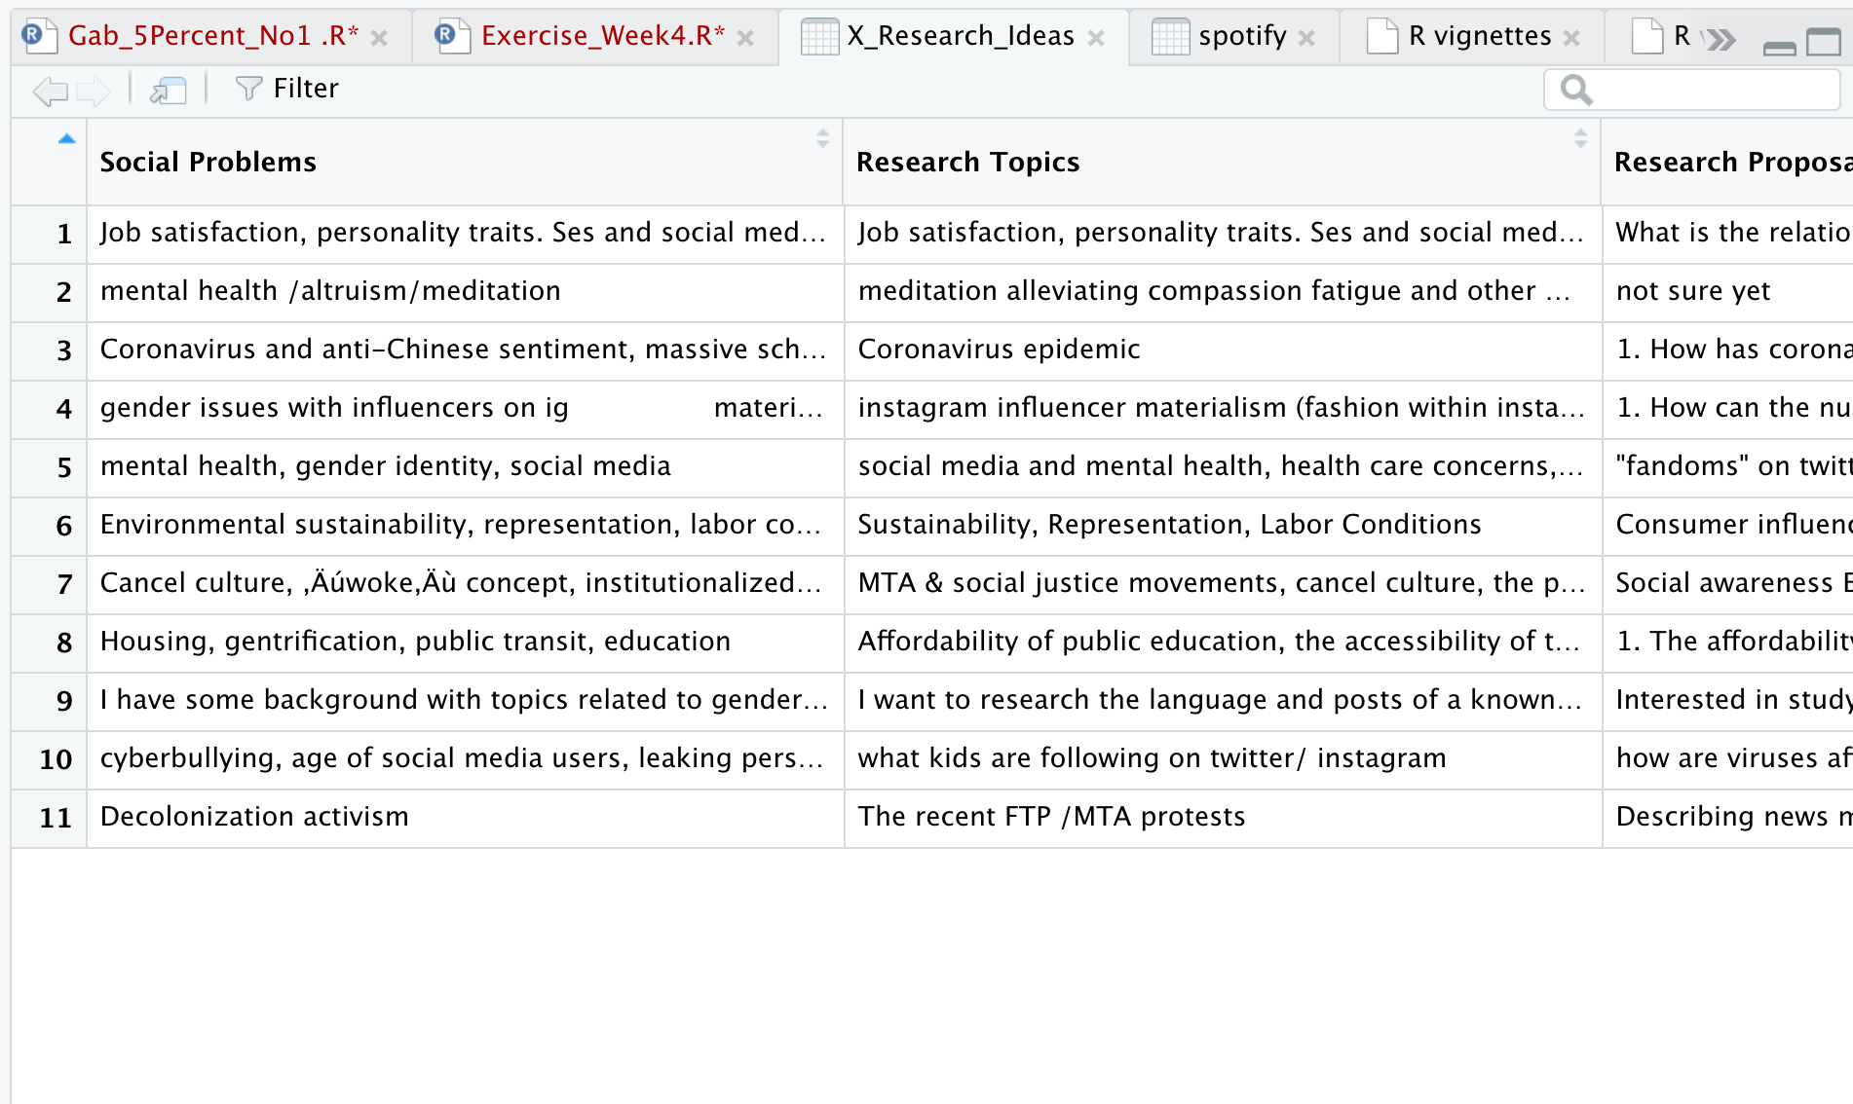
Click Import

Slide 46
Data Wrangling
We will use the spotify data set as an example in class
library(tidyverse)
spotify <- read_csv("spotify.csv")
Take a look at the dataset:
spotify

Slide 47
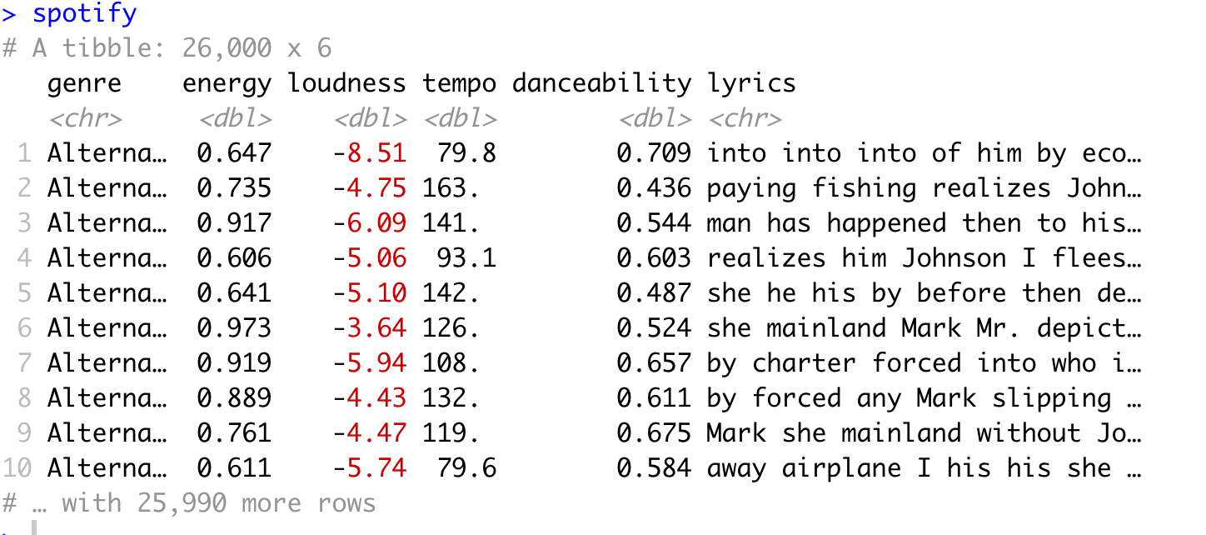
Data Wrangling (Cont.)

Slide 48
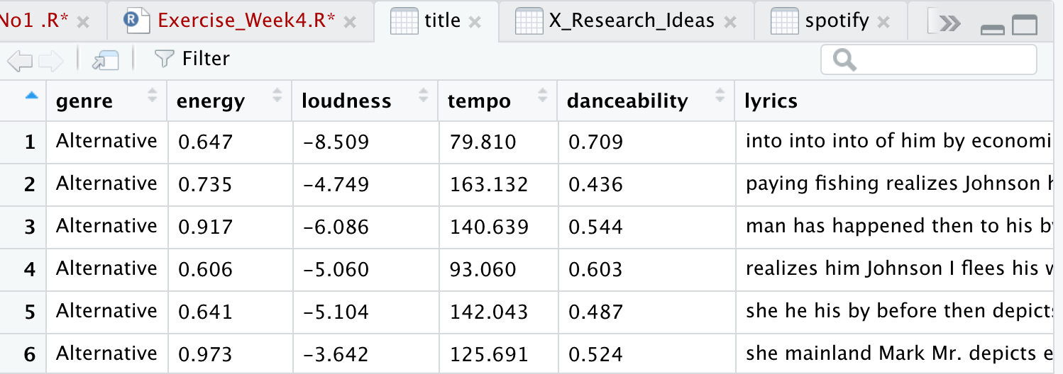
Data Wrangling (cont)
If you use view(spotify), a data frame would come up.

Slide 49
Let’s summarize the key info in this data set
Which music genre has the most energy?
Which music genre is the loudest?
Which one has the fastest tempo?

Slide 50
Unique()
unique(spotify$genre)
[1] "Alternative" "Anime" "Blues"
[4] "Children's Music" "Children’s Music" "Classical"
[7] "Comedy" "Country" "Dance"
[10] "Electronic" "Folk" "Hip-Hop"
[13] "Indie" "Jazz" "Movie"
[16] "Opera" "Pop" "R&B"
[19] "Rap" "Reggae" "Reggaeton"
[22] "Rock" "Ska" "Soul"
[25] "Soundtrack" "World"

Slide 51
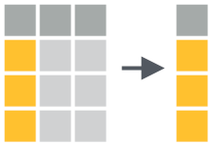
Select()
select(spotify, loudness)
select(spotify, -lyrics)

Slide 52
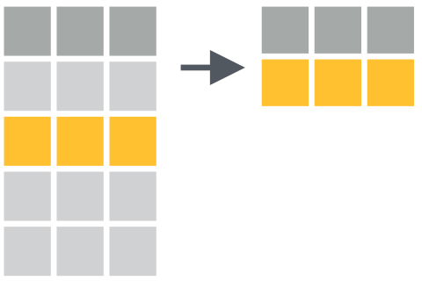
filter()
filter() extracts rows from a dataframe and returns them as a new data frame. The first argument of filter() should be a data frame to extract rows from. The arguments that follow should be logical tests; filter() will return every row for which the tests return TRUE.

Slide 53
filter()
filter(spotify, genre == "Alternative")
# A tibble: 1,000 x 6
genre energy loudness tempo danceability lyrics
<chr> <dbl> <dbl> <dbl> <dbl> <chr>
1 Alterna… 0.647 -8.51 79.8 0.709 into into into of him by eco…
2 Alterna… 0.735 -4.75 163. 0.436 paying fishing realizes John…
3 Alterna… 0.917 -6.09 141. 0.544 man has happened then to his…
4 Alterna… 0.606 -5.06 93.1 0.603 realizes him Johnson I flees…
5 Alterna… 0.641 -5.10 142. 0.487 she he his by before then de…
6 Alterna… 0.973 -3.64 126. 0.524 she mainland Mark Mr. depict…
7 Alterna… 0.919 -5.94 108. 0.657 by charter forced into who i…
8 Alterna… 0.889 -4.43 132. 0.611 by forced any Mark slipping …
9 Alterna… 0.761 -4.47 119. 0.675 Mark she mainland without Jo…
10 Alterna… 0.611 -5.74 79.6 0.584 away airplane I his his she …
# … with 990 more rows

Slide 54
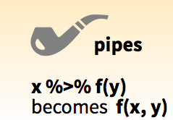
Piping - %>%

Slide 55
The pipe operator %>% performs an extremely simple task: it passes the result on its left into the first argument of the function on its right. Or put another way, x %>% f(y) is the same as f(x, y). This piece of code punctuation makes it easy to write and read series of functions that are applied in a step by step way.

Slide 56
Summarizing Data
spotify %>%
filter(genre == "Rock") %>%
summarise(avg_energy = mean(energy))
summarise() takes a data frame and uses it to calculate a new data frame of summary statistics.

Slide 57
Result
# A tibble: 1 x 1
avg_energy
<dbl>
1 0.682

Slide 58
More summarizing
spotify %>%
filter(genre == "Rock") %>%
summarise(
avg_energy = mean(energy),
max_energy = max(energy),
total_energy = sum(energy)
)

Slide 59
Result
# A tibble: 1 x 3
avg_energy max_energy total_energy
<dbl> <dbl> <dbl>
1 0.682 0.995 682.

Slide 60
Exercise
Compute these three statistics:
the average loudness of blues songs (mean())
the maximum danceability of any blues song (max())
the minimum energy of any blues song (min())
Remember, you will have to use filter() to filter for blues songs!

Slide 61
group_by()
group_by() assigns grouping criteria that is stored as metadata alongside the original data set.
group_by() takes a data frame and then the names of one or more columns in the data frame. It returns a copy of the data frame that has been “grouped” into sets of rows that share identical combinations of values in the specified columns.
For example, the result below is grouped into rows that have the same genre.
spotify %>%
group_by(genre)

Slide 62
Exercise
select the columns you need (genre and energy)
filter for your 4 genres of interest
group the genres
calculate the mean energy for each genre

Slide 63
Group_by()
# A tibble: 26,000 x 6
# Groups: genre [26]
genre energy loudness tempo danceability lyrics
<chr> <dbl> <dbl> <dbl> <dbl> <chr>
1 Alterna… 0.647 -8.51 79.8 0.709 into into into of him by eco…
2 Alterna… 0.735 -4.75 163. 0.436 paying fishing realizes John…
3 Alterna… 0.917 -6.09 141. 0.544 man has happened then to his…
4 Alterna… 0.606 -5.06 93.1 0.603 realizes him Johnson I flees…
5 Alterna… 0.641 -5.10 142. 0.487 she he his by before then de…
6 Alterna… 0.973 -3.64 126. 0.524 she mainland Mark Mr. depict…
7 Alterna… 0.919 -5.94 108. 0.657 by charter forced into who i…
8 Alterna… 0.889 -4.43 132. 0.611 by forced any Mark slipping …
9 Alterna… 0.761 -4.47 119. 0.675 Mark she mainland without Jo…
10 Alterna… 0.611 -5.74 79.6 0.584 away airplane I his his she …
# … with 25,990 more rows

